Slide 2
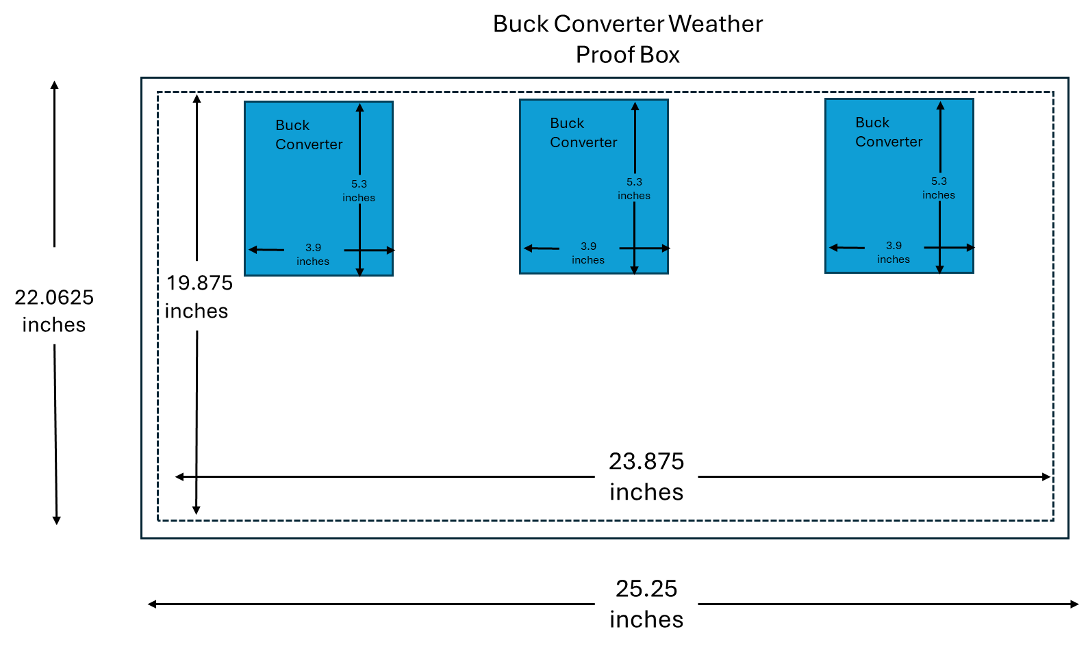
Kairos Back Seat
Battery
Kairos
Hyperdrive Computer
13 inches
17 inches
20
inches
34 inches
11 inches
14 inches
Hyperdrive
Router
10 inches
11.2
inches
9 inches
44 inches

Slide 3
Buck Converter Weather Proof Box
Buck Converter
Buck Converter
Buck Converter
5.3
inches
5.3
inches
5.3
inches
22.0625 inches
3.9
inches
3.9
inches
3.9
inches
19.875 inches
23.875 inches
25.25 inches

